Slide 1

Unsupervised Deep Learning ZG533
Dr. Sugata Ghosal
sugata.ghosal@pilani.bits-pilani.ac.in

Slide 2
Session 8
These slides are prepared by the instructor, with grateful acknowledgement of many others who made their course materials freely available online.

Slide 3
Midsem Tips
Do not forget to carry a scientific calculator in the exam room,
Refresh your skills on backpropagation, weight updates, CNN and convolution operation of various types, their parameter calculation.
Syllabus includes Introduction, PCA and variants, Autoencoders, Autoregressive Models (e.g., MADE, Wavenet, PixelCNN and variants), Flow Model and variants.
Make sure to review the past question papers posted in Taxila. And practise questions/solutions.
Questions may be asked on and around Assignment 1 - code writing and syntax wont be asked but ability to read python code, and relevant libraries and their interpretation is expected. Also conceptual understanding on the assignment tasks may come handy during the exam.
Most of the questions will be quantitative in nature. Minor calculation mistakes will be mostly overlooked.

Slide 4
Assignment Related Question Example
The following code is used to create the encoder of a convolutional autoencoder:
encoder = Sequential([ Conv2D(32,(3,3),activation='relu', padding='same', input_shape=(28,28,1)), MaxPooling2D((2,2)), Conv2D(64,(3,3), activation='relu', padding='same'), MaxPooling2D((2,2)), Flatten(), Dense(30,name='latent') ])
(a) Determine the output dimensions after each layer. Show your calculations. [3]
(b) Explain why the latent layer contains only 30 neurons. What role does it play in representation learning? [2]
(c) Calculate the number of trainable parameters in the first convolutional layer. [2]
(d) Explain what would happen if both MaxPooling layers were removed. Discuss effects on latent representation, computational complexity, and reconstruction quality. [3]

Slide 5
Assignment Related Question Example
Original:
Conv2D(32,(3,3),activation='relu') Conv2D(64,(3,3),activation='relu')
Modified:
Conv2D(32,(7,7),activation='relu') Conv2D(64,(7,7),activation='relu’)
(a) How will the number of trainable parameters change? [2]
(b) How will training time be affected? [2]
(c) How will the receptive field change? [2]
(d) Discuss possible positive and negative effects on reconstruction accuracy. [4]

Slide 6
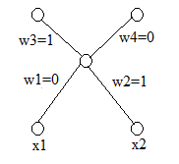
AE Question Example
Consider a fully connected autoencoder (each hidden node is connected to all inputs and all outputs) with two dimensional binary input and one hidden layer with sigmoid activation function. At iteration t, the weights are shown in the following autoencoder architecture along with the input vector (x1=1, x2=0). All bias values are zero. Assume learning rate = 0.25 and momentum constant = 0.75. Also assume at t-1, w1= -0.5, w2=0.5, w3=0.5 and w4= -0.5.
What activation function will you choose at the output node?
What loss function will you choose for training this autoencoder?
What will be the value of loss function at iteration t?
What will be the weights w1 and w3 in iteration t+1 assuming ordinaryradient descent?

Slide 7
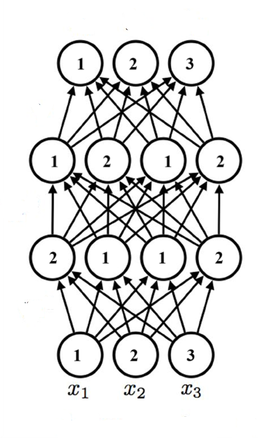
AR Model Question Example
Assume the following MADE is used to calculate p(x₁), p(x₂|x1), p(x₃|x₂, x₁). x_{t} is the data value at time t and x1 arrives first and so on as shown on the figure. All node numbering is given. Design all the necessary masks and show the final connections. Show all steps.

Slide 8
Flow Question Example
Consider transforming a uniform base density defined on z ∈ [0, 1] using the function x = f[z] = z² is a flow model. Find an expression for the transformed distribution Pr(x).
Are the following functions invertible or not? Why?
z=f(x)=x³ – x⁵ + 2x⁷
z=f(x)=exp(-|x|)
z=f(x)=x² – x

